Slide 1

PROTOTYPING OF BUILDING AUTOMATION SYSTEMS
T.V.VIGNESH
Reg. 100906133
4th Year, B.Tech Student
Dept. of E&E,
MIT MANIPAL
GAURAV ANAND
Reg. 100906537
4th Year, B.Tech Student
Dept. of E&E,
MIT MANIPAL
Mr. Vedavyasa Kamath
Assistant Professor
Dept. of E&E,
MIT MANIPAL

Slide 2

AN OUTLINE
Introduction
Objectives
Modules Involved
Methodology & Block Diagrams
Software/Hardware details
Result Analysis
Conclusion
References
Demonstration

Slide 3

INTRODUCTION
Building Automation Systems
The Prototype
Devices Controlled & Monitored
Current Status & Future Scope

Slide 4
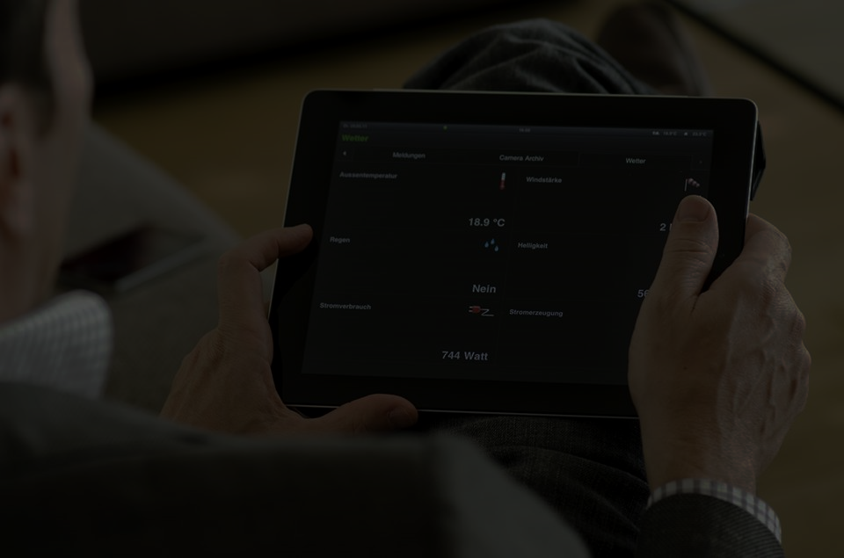
CORE OBJECTIVES
CONTROL ELECTRICAL & ELECTRONIC DEVICES
SENSING PARAMETERS OF THE SYSTEM & SURROUNDINGS
ENABLE FLEXIBLE ACCESS OF THE USER INTERFACE
CREATING A COMMERCIALLY VIABLE SYSTEM

Slide 5
MODULES INVOLVED
LIGHT CONTROL
LIGHT SENSING
TEMPERATURE & HUMIDITY SENSING
SWITCHING DEVICES
MOTION SENSING
AC-DC CONVERSION
DOOR SENSING
RF COMMUNICATION
USER INTERFACE & SERVER-DATABASE INTERGRATION

Slide 6
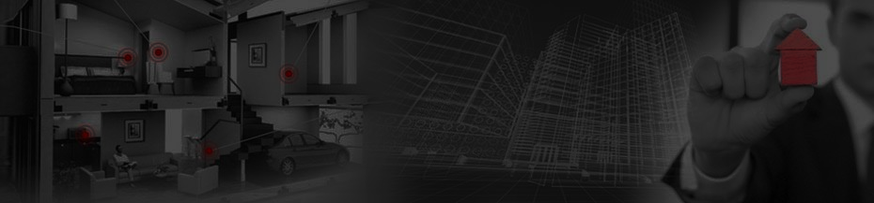
THE SYSTEM
RASPBERRY PI
POWER SYSTEM
ACTUATORS
USER INTERFACE
CHANNEL
POWER SUPPLY
ARDUINO SUBSTATION

Slide 7

CHANNEL
RF (NRF24L01+) AND Wi-Fi

Slide 8

BLOCK DIAGRAM
INTERNET CHANNEL
INDIRECT I/O
I/O INTERFACE
(DIRECT ACCESS)
CENTRALIZED
MICROPROCESSOR
(RASPBERRY PI)
Supporting Supply
RF CHANNEL
Sensors
Arduino Substation
Actuators
Plant

Slide 9
BLOCK DIAGRAM
Web Server
Microprocessor
(Raspberry PI)
Microcontroller
(Arduino)
Lighting
Security
Switching
User Interface

Slide 10
LIGHTING
USER INTERFACE
ARDUINO SUBSTATION
CHANNEL - RF
RASPBERRY PI 2 BASE STATION
CHANNEL - INTERNET
PWM OUTPUT ADJUSTED BY P CONTROLLER
AMPLIFICATION AND FILTER CIRCUITS
DIGITAL BALLAST
LIGHT FIXTURE
LIGHT SENSOR

Slide 11
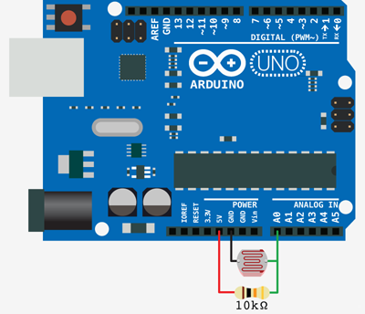
LIGHT SENSING

Slide 12
SWITCHING DEVICES
USER INTERFACE
ARDUINO SUBSTATION
CHANNEL - RF
RASPBERRY PI 2 BASE STATION
CHANNEL - INTERNET
GPIO OUTPUT
ELECTRONIC RELAY
POWER SYSTEM DEVICE

Slide 13
POWER SUPPLY CONVERSION
220V AC MAINS
AMPLIFIER SUPPLY
TWO LM7812 VOLTAGE REGULATORS
BRIDGE RECTIFIER
12V AC STEP DOWN TRANSFORMER

Slide 14
RF COMMUNICATION
USER INTERFACE
ARDUINO SUBSTATION
RF TRANSCEIVER (PI SIDE)
RASPBERRY PI 2 BASE STATION
CHANNEL - INTERNET
GPIO OUTPUT
RF TRANSCEIVER (ARDUINO SIDE)

Slide 15
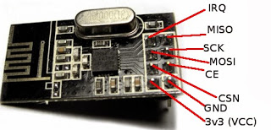
RF COMMUNICATION

Slide 16
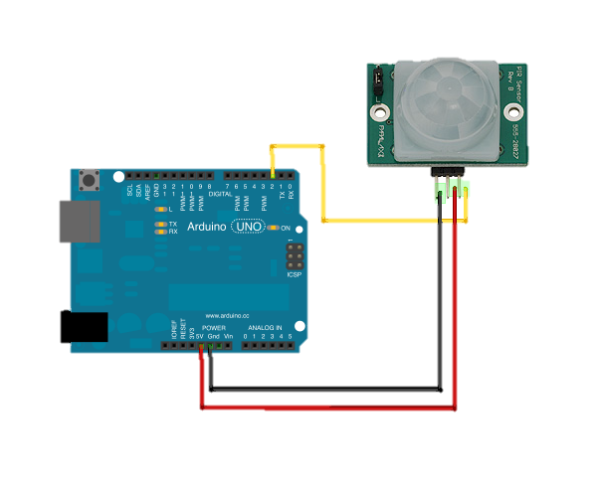
MOTION SENSING (PIR SENSOR)

Slide 17
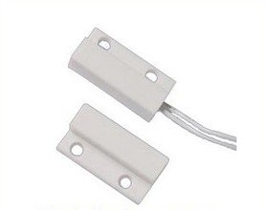
DOOR SENSING (REED RELAY)

Slide 18
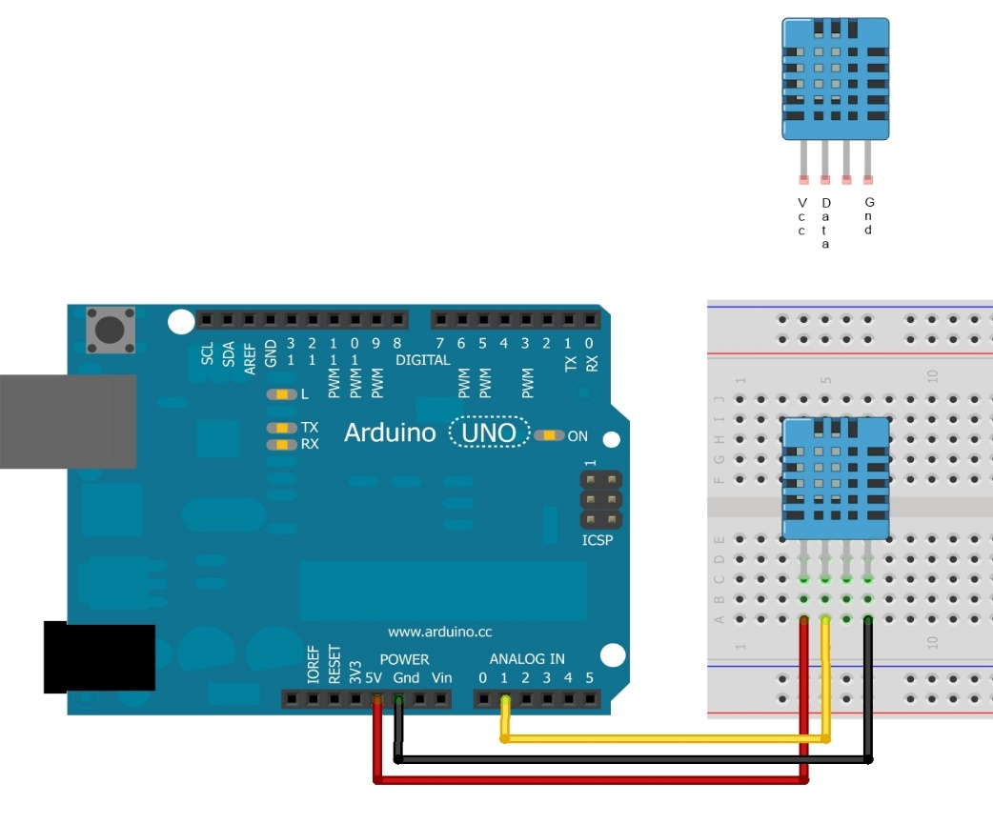
TEMPERATURE & HUMIDITY SENSING

Slide 19
SWITCHING DEVICES

Slide 20
PROBLEMS ENCOUNTERED AND CORRECTIVE STEPS TAKEN
BURNT RASPBERRY PI
BURNT RELAY
DRIVER CONFIGURATION
DEVICE HUNT
SHOCK
MESSED UP WIRING
NOISE IN AMPLIFICATION CIRCUIT
NON FUNCTIONAL DEVICES
RF COMMUNICATION DRIVERS & PROBLEMS

Slide 21
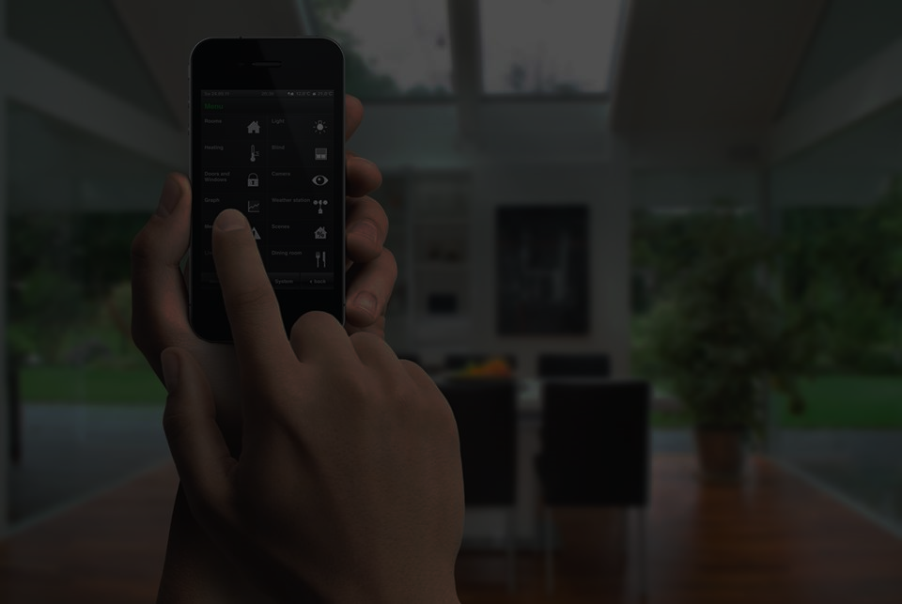
HARDWARE DETAILS
Raspberry PI 2 Model B
&
ARDUINO
Connectors & Board
Wi-Fi Dongle & Xbee
SENSORS
RESISTORS
CAPACITORS
TRANSISTORS
RELAYS
RECTIFIERS & ACTUATORS
ADC
STEP DOWN TRANSFORMER
I/O DISPLAY
DIODES
DC-DC BOOST CONVERTER
DC POWER SUPPLY

Slide 22
HARDWARE DETAILS
SENSORS
Light
Temperature
Motion
Humidity
Door

Slide 23

SOFTWARE DETAILS
HTML
CSS
JAVASCRIPT & JQUERY
PHP
MySQL
PYTHON
LINUX SHELL
C++

Slide 24
RESULT ANALYSIS & DEMONSTRATION

Slide 25

CONCLUSION
http://tinyurl.com/mybas

Slide 26

THANK YOU…
ANY QUESTIONS?

